Slide 1

Team Dolan

Slide 2




Meet the Team
Ujjawal Aggarwal
Aaryaman Saini
(Team Leader)
Lydia Koilparambil

Slide 3

3.7B
HAPPY
CUSTOMERS
$39.1B
REVENUE GENERATED
IN FY 2019-20
25.1M
ORDERS
IN FY 2019-20
17
COUNTRIES PRODUCING >100K
ORDERS
350+
ATHLETES TRUSTED BRAND
75K+
EMPLOYEES
1096
RETAIL STORES WORLDWIDE
5+
AWARDS

Slide 4

NIKE
NIKE
Analysis
Analysis
Insights
DATA
Insights
DATA

Slide 5

Our Analysis is based on the following assumptions to make data more manageable
The time range we have chosen for our analysis of Nike’s Data is from August 1, 2020 to October 7, 2020, because of the seasonality and high loading time of May data.
The analysis, insights and recommendations provided in the following slides are solely based on data from Nike’s website and not from Nike’s mobile application.
For some Dimensions, percentage of Unspecified/Undefined data was more than 95. So, in those cases, we decided to ignore those dimensions.

Slide 6
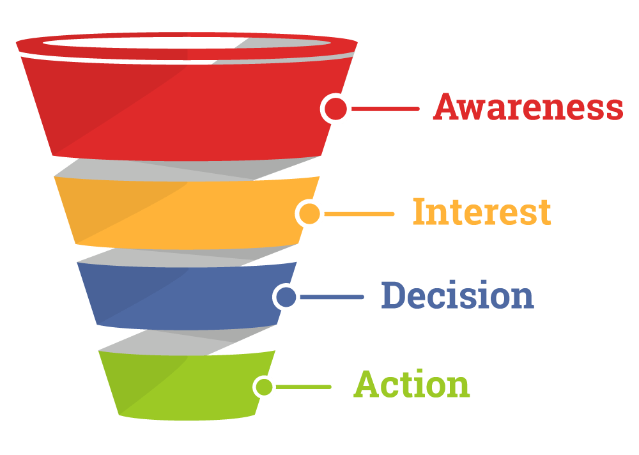
How can we drive users down the Member Funnel ?
Unknown to Nike
Known to Nike
Members
Gamified Engagement

Slide 7

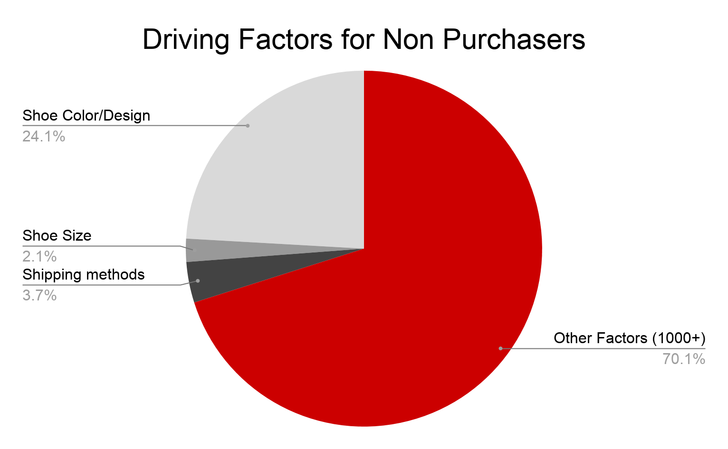
Evaluating things that occur in a session that doesn’t purchase
Notes:
Analysis: Out of 5.4%(189M) users that exits from the cart without purchasing anything consists of 3.7% (6.9M) users because of the unavailability of their desired SHIPPING METHOD, 2.1% (3.9M) users because they couldn’t find their preferred shoe SIZE which is typically (Size M), 24% (47M) users because of the current color(mainly black/white) or combinations they have. Factors may have overlapping customers.

Slide 8
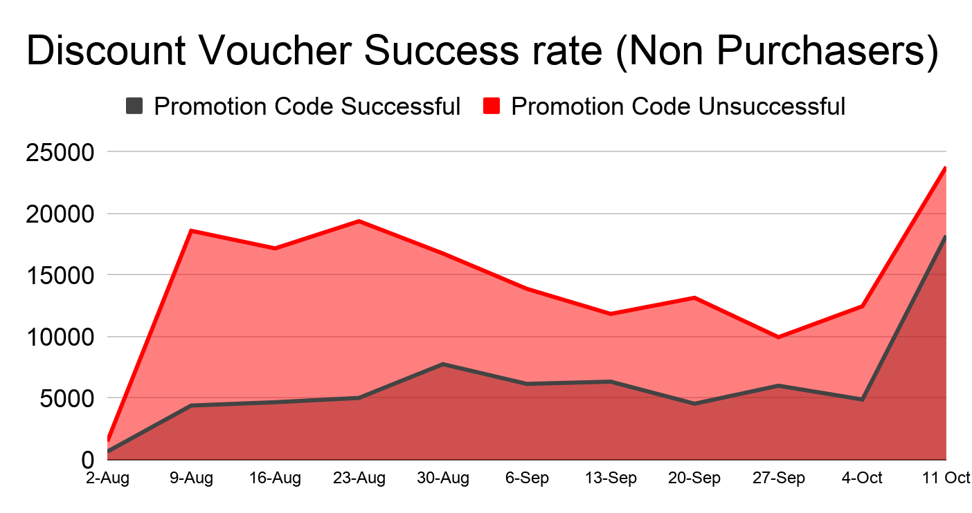
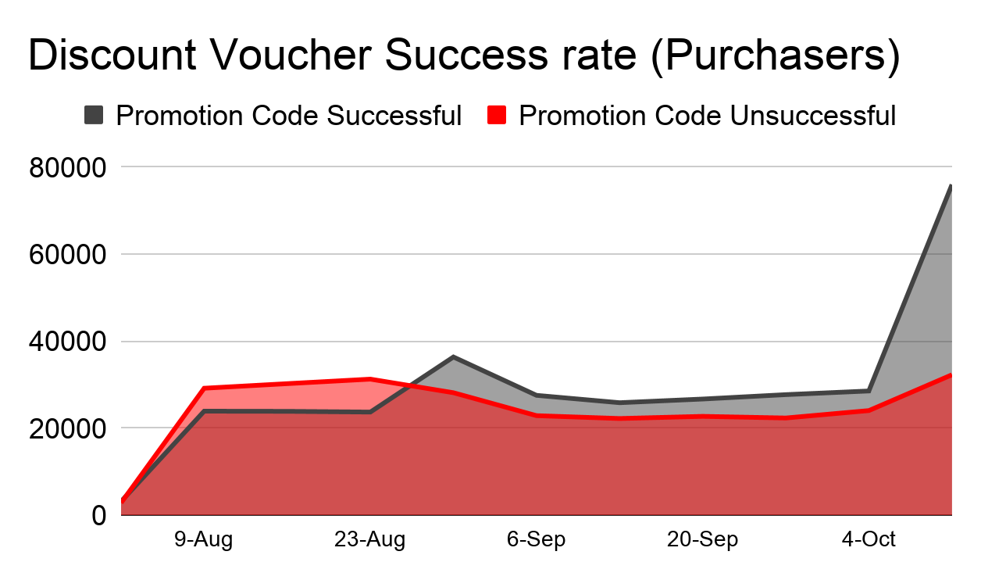
In case of Non Purchasers, Out of 225K when the promotion code is applied, 160K times code doesn't work and drive the user away disappointed.
On the other hand, Out of 590K times promotion code is applied, 323K times code work and help in the purchase order.

Slide 9
Recommendations
Providing more Reliable and User likely shipping methods.
Increasing the quantity of Shoes in each size category may increase in purchase number. Moreover, M size category is the most favourable among the customers.
Improving the colour(black/white) ranges/designs for every shoes may help to drive the user.
Providing more consistent and working promotion code instead of changing every week may help the user to buy products.
Notes:
Note: Shipping methods provided in the data comprises of some code, couldn't understand much. But it looks like users are not happy with the current one.

Slide 10
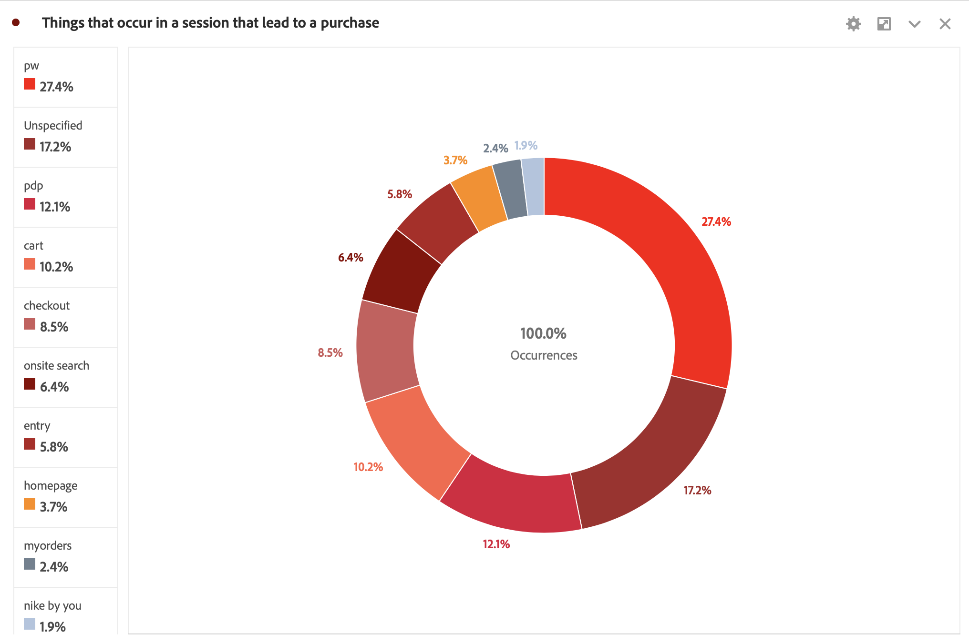
Enumerating things that occur in a purchasing session, other than PDP visits and Add to Cart
Notes:
Segment used Purchasers.

Slide 11
INSIGHTS
Things of importance in the donut chart on previous slide, are as follows:
Product Wall : 27.4 %
Onsite Search : 6.4 %
Nike By You : 1.9 %
Many people spending a lot of their time on Product Walls, shows that they are interested in Nike and are willing to checkout new products. This can be seen as a common and obvious feature for users that do make a purchase.
Notes:
Segment used Purchasers.

Slide 12
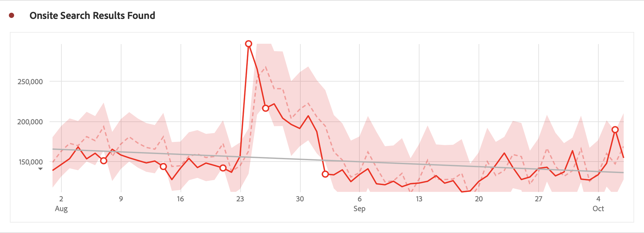
Onsite Search
Onsite Search Data, tells us that user knows the product he/she wants and will eventually make purchase.
The trend shows a small decrease.
Reason: Reduction in sales due to increasing COVID cases
Notes:
Segment used Purchasers.

Slide 13
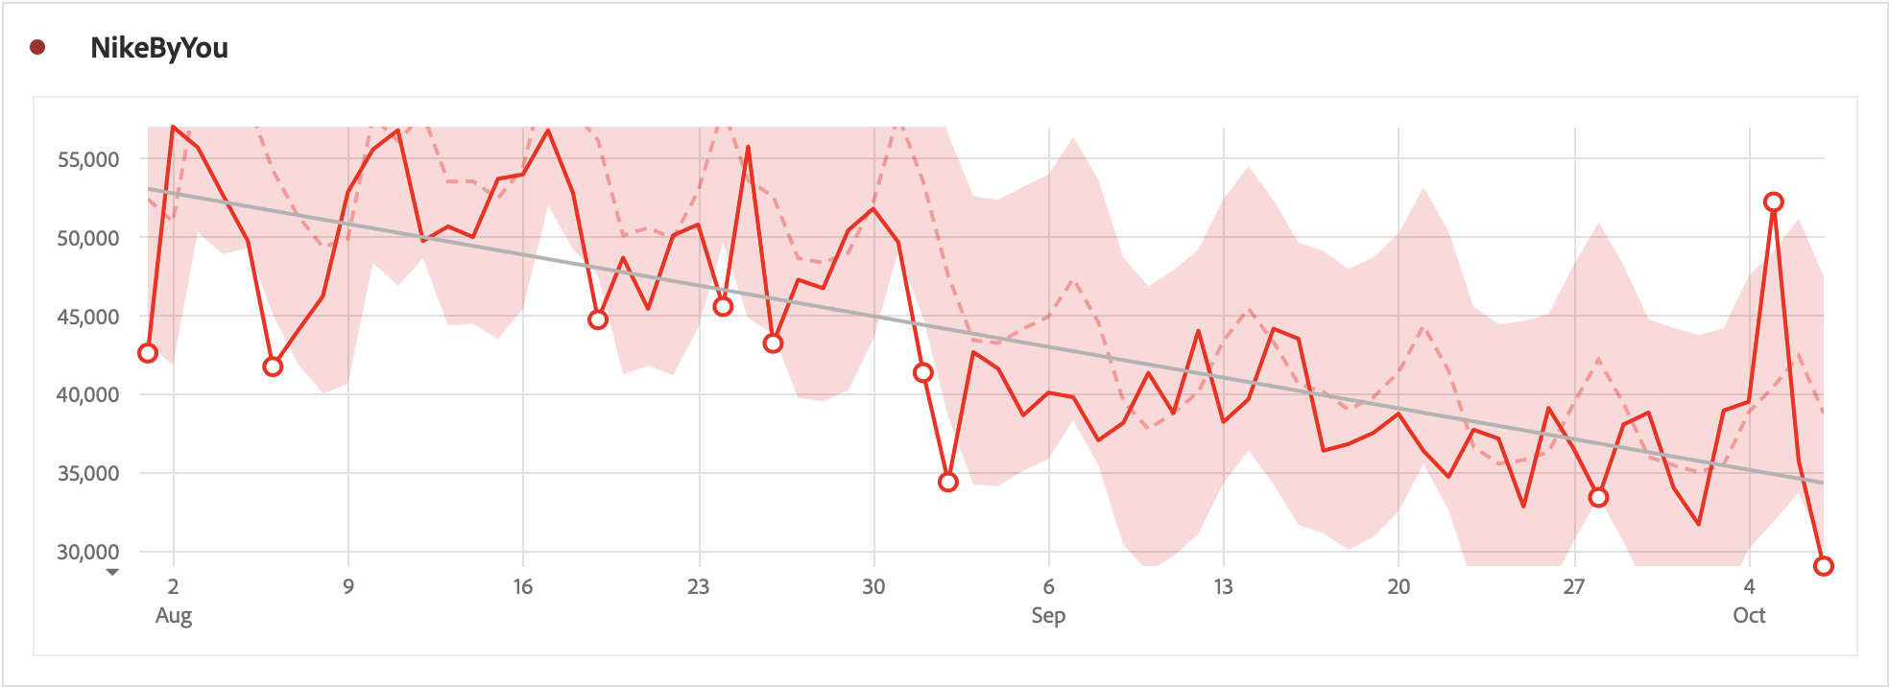
Nike By You
There is a noticeable decrease in the trend.
Customised products are more expensive and again because of COVID, people do no want to spend much.
NikeByYou is a very important feature as buyers like to customise products and make it their own.
Customizing products is one of those things that occur in a session that does lead to a purchase.

Slide 14
Recommendations
Having an improved recommendations by learning from user’s wish list, can make users stay longer and thus tend them to purchase more products.
Advertise Nike By You more with influencers and perhaps, reduce prices for these products.
Making the search of products more customizable will give more freedom to user.

Slide 15
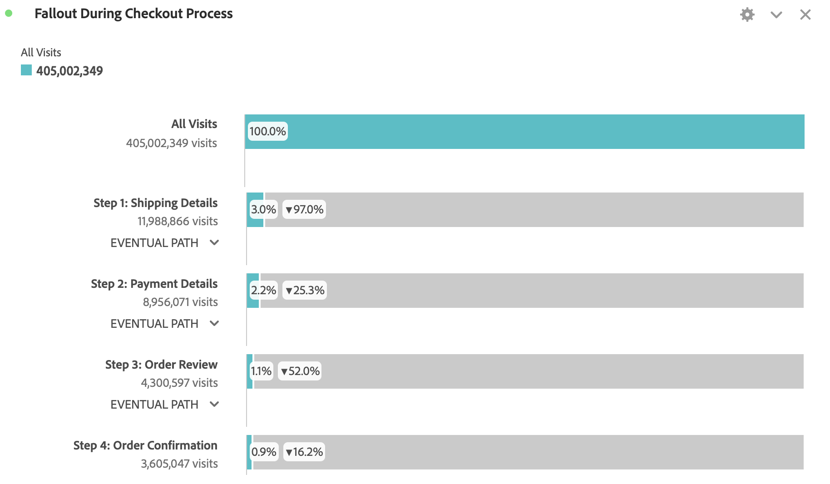
Optimizations in the Checkout Process
Half of those who decide to buy don’t fill in payment details.
This could be due to high ratio of PROMO codes failure.
So, the largest opportunity for optimization to minimize fallout in the checkout experience is Payment Details.

Slide 16
Recommendations
Adding varied payment methods, storing customers payment details for later, giving assurance about the security of their card details are some of the ways that can help customers add details hassle-free.
Providing promo codes on the checkout page can reduce fallout.

Slide 17
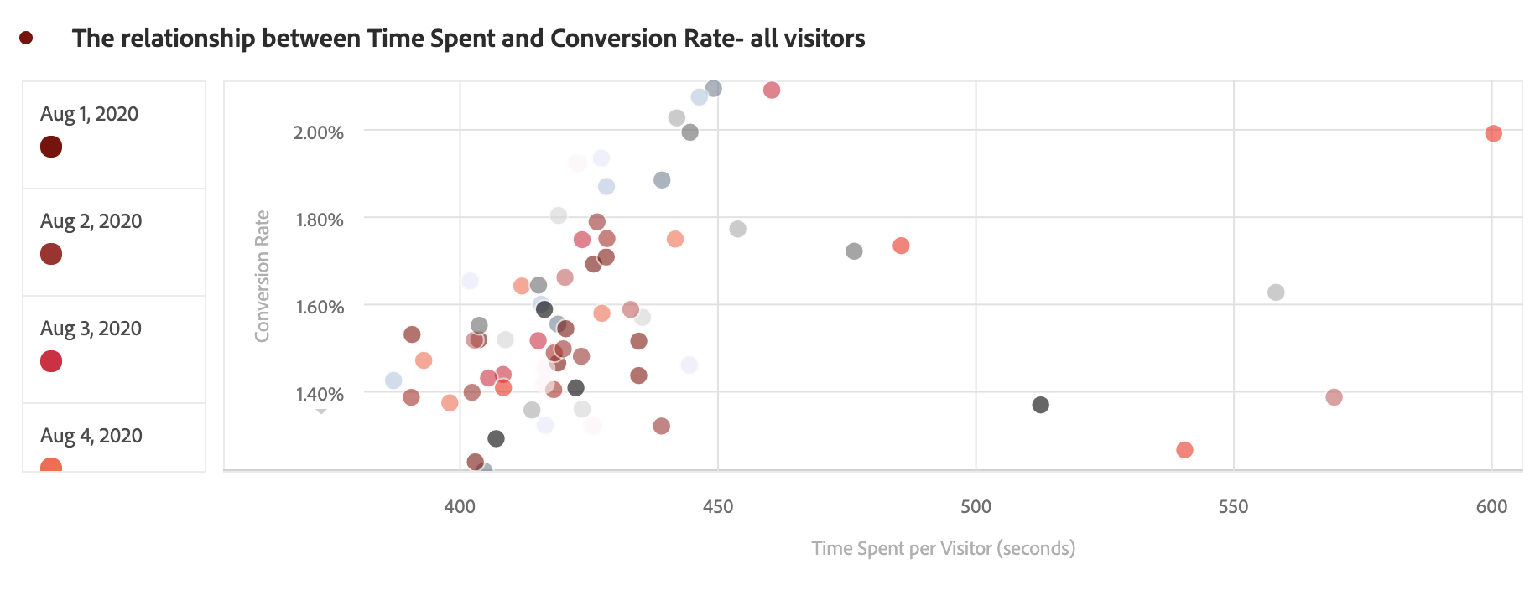
Session Length to Conversion Rate
Purchasers
Mean: 700 sec Median: 708 sec
Non Purchaser
Mean: 342 sec Median: 333 sec
Correlation ≠ Causation
However, we do see that out of all visitors, the ones spending 430 sec to 470 sec will give higher conversion rates.

Slide 18
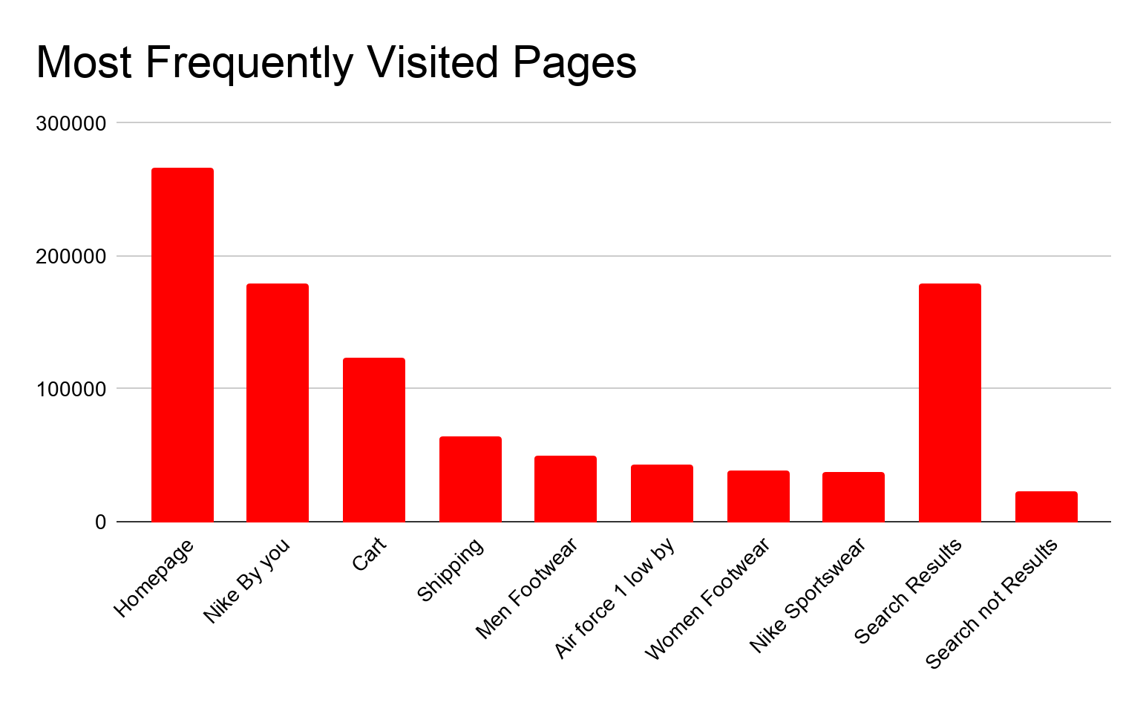
Identifying the parts of the purchase experience when people log in
Interesting things to note here that after Homepage, Nike by you, and cart pages, people mostly search for Men footwear, Women footwear and Nike Sportswear.
Another Interesting thing to point is what people search on website mostly leads to error 404.This could be because of customer typing the wrong product description, wrong product code or some other reasons.

Slide 19
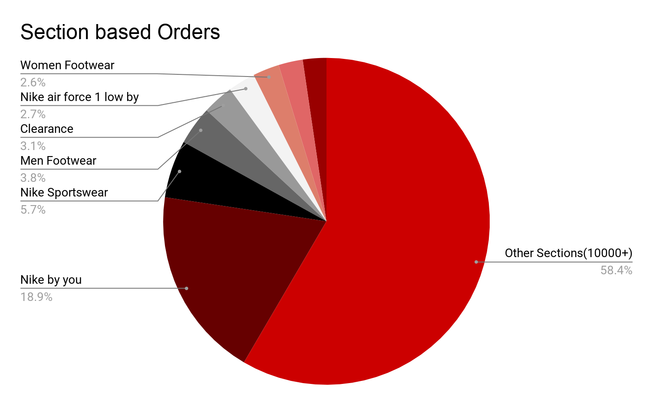
Notes:
Analysis: Besides, orders from Nike By you, Second most orders are from Mens footwears, Nike sportswear, Clearance Section and Nike Air Force One sections. These are the ones to focus on. Sections may have overlapping customers.Also we notice that, customers are moving towards Nike by you side with a very fast rate.

Slide 20
Recommendations
Improving Men footwear, Air force one, Women Footwear website interface and adding more product ranges to these sections helps in more number of purchase orders.
Providing more customization options in Non-customizable shoes range will help the customers to create the product according to their personality.
Upgrading your Onsite Search algorithm may show significant amount of growth in successful Search results.
Adding more products to Clearance section because the customers tend to buy more from sales.

Slide 21
So, Nike CAN drive members down the funnel:
Invest on advertising in social media. Since, this platform is increasing like never before.
UNKNOWN TO NIKE -> KNOWN TO NIKE
Produce different ranges of products, give out promo codes, make site more interactive and improve searching algorithm.
KNOWN TO NIKE -> MEMBERS
Spread awareness about Nike By You, keep members updated about community and latest virtual gaming.
MEMBERS -> GAMIFIED ENGAGEMENT

Slide 22
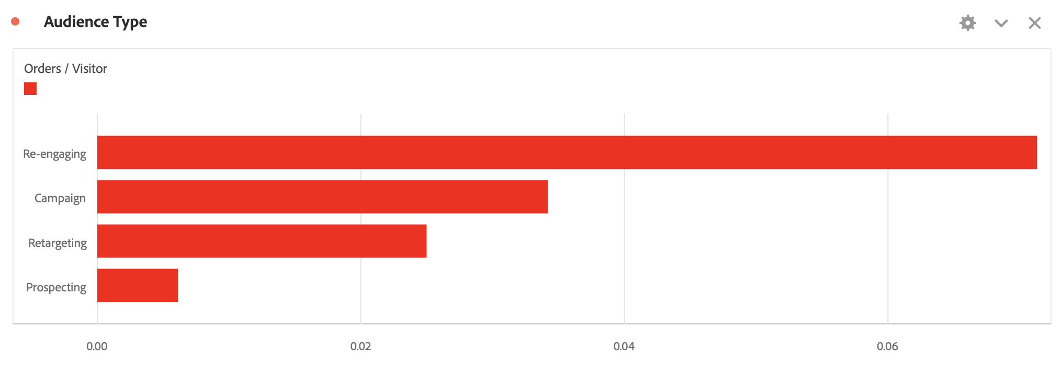
Who are the best users to target ?
Notes:
WORK IT

Slide 23
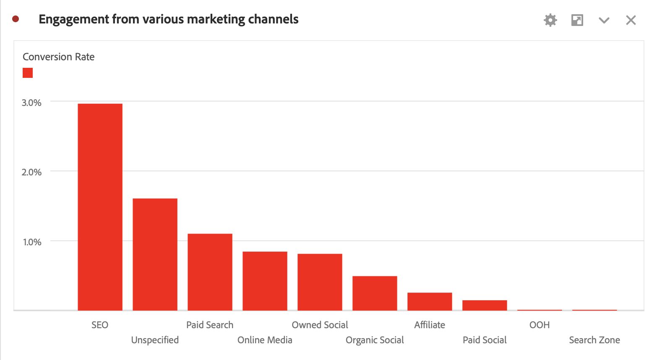
Assessing the ways in which later behaviour is modified by marketing channel cohorts
First, we can see that the maximum engagement we get is from SEO and thus higher conversion rate.
Online media and social sites is not bringing people with higher conversion rates but it brings in new users.

Slide 24
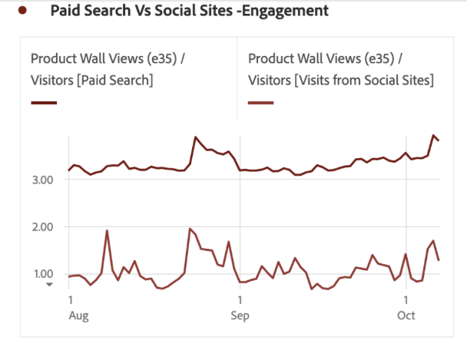
INSIGHTS
Therefore,
Paid Search brings more CUSTOMERS.
Social Sites bring more VISITORS to Nike.

Slide 25
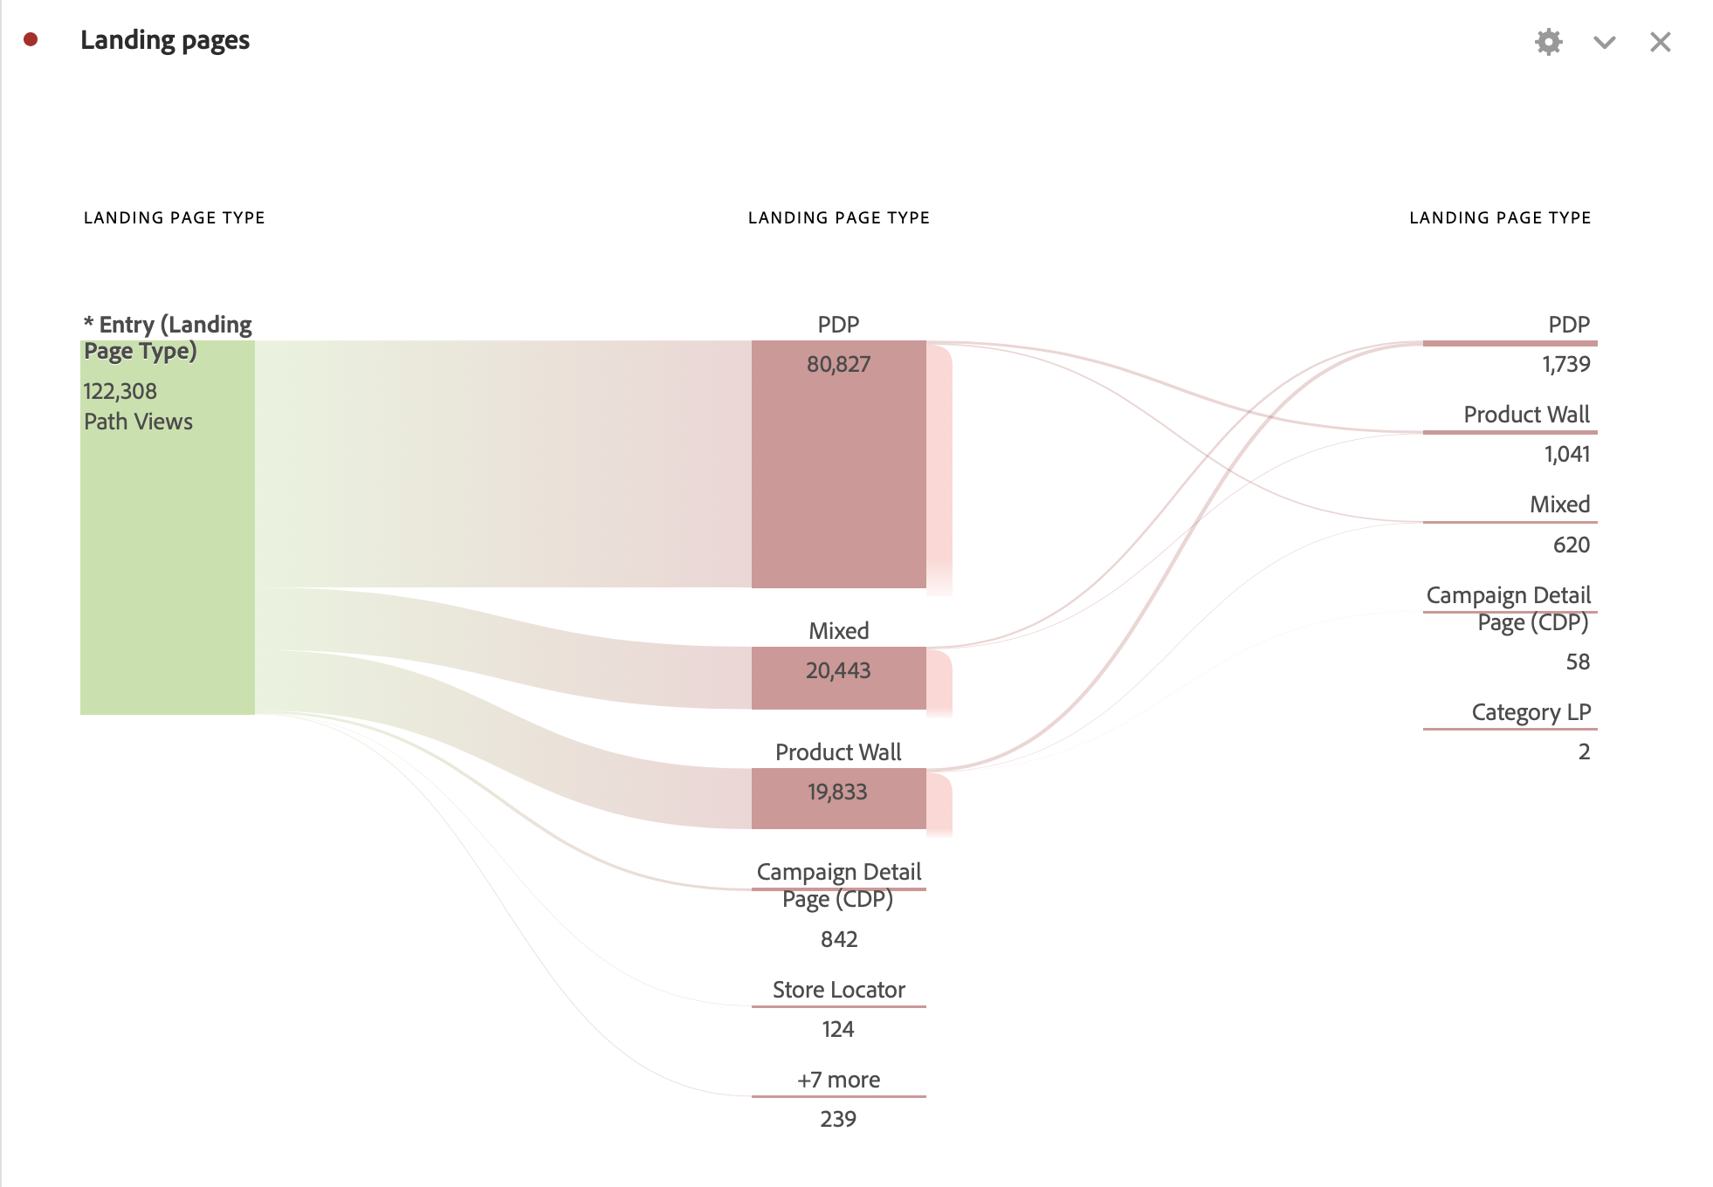
Determining movement into a purchase behaviour using engagement
If people are spending more time on PDPs and Product walls, then they will definitely tend to make a purchase. Also, from the flow chart, we see that users’ landing pages are PDPs, Product Walls and Campaign Details.

Slide 26
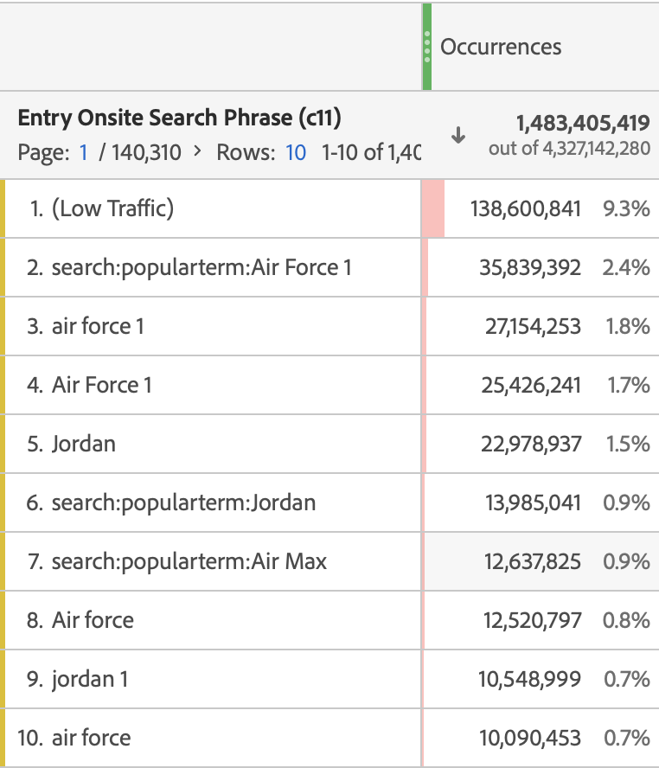
For entry onsite searches, the top things that people are looking for are Air Force 1, Jordan and Air Max. This engagement also lead to purchase behaviour.
Engagement that could lead to purchase, greatly depends on products but also on services provided by Nike.

Slide 27
Recommendations
Mailing customers after purchase with options to style their item with more Nike products, can get them into Nike community.
Giving discounts for purchasing an item within an hour, will increase buyers engagement.

Slide 28
So, The best users for Nike to Target:
Target market for online sales is that coming from social sites with the help of advertising on these platform.
Customising products with the help of Nike By You gives users the feel of instore shopping. The audience in this sector yields higher conversion rates.
Also, keeping members engaged will ensure longevity and requires less investment than acquiring new ones.

Slide 29


